Slide 1
Predicting Activity with a Smartphone

Slide 2
Overview
Human Activity Recognition, or HAR) for short, is the problem of predicting what a person is doing based on a trace of their movement using sensors.
Movements are often normal indoor activities such as standing, sitting, laying, walking, and walking up/downstairs.
This research is widely applicable to many industries including healthcare, teaching, and construction.

Slide 3
Problem Statement
Can the activity of an individual be accurately predicted with a smart phone’s internal sensors?
What variables are most important for a model to predict with a smart phone?
Which model most accurately predicts activity with a smart phone?

Slide 4
Background
Found on Kaggle: https://www.kaggle.com/uciml/human-activity-recognition-with-smartphones
Data was collected from 30 subjects aged between 19 and 48 years old performing one of 6 standard activities
Subjects wore a waist-mounted smartphone that recorded the movement data
https://www.youtube.com/watch?v=XOEN9W05_4A
Notes:
Moving from research question to some kind of hypothesis -- you want to use logic, theory and prior empirical evidence to move toward some hypotheses you can test. This is why domain expertise cannot be overlooked among data scientists.

Slide 5
Why care about Smartphone Sensor?
Given the rising healthcare costs, and the current pandemic situation, makes things tougher for the patients with chronic conditions.
Smartphones are increasingly common around the world and are incorporating more inertial sensors such as accelerometers, gyroscopes, and magnetometer.
This makes smart phones an ideal tool to reach a large section of the population and is not as restricted by location or battery life.
Notes:
Moving from research question to some kind of hypothesis -- you want to use logic, theory and prior empirical evidence to move toward some hypotheses you can test. This is why domain expertise cannot be overlooked among data scientists.

Slide 6
From Data to Modeling
Dataset has a very large number of features. And the features come from the accelerometer and gyroscope 3-axial raw signals.
Features are normalized and bound within [-1,1]
Each feature vector is a row on the ‘X’ and ‘y’ files
Units used for the accelerations (total and body) are ‘g’s
Gyroscope units are rad/seg
Notes:
Moving from research question to some kind of hypothesis -- you want to use logic, theory and prior empirical evidence to move toward some hypotheses you can test. This is why domain expertise cannot be overlooked among data scientists.

Slide 7
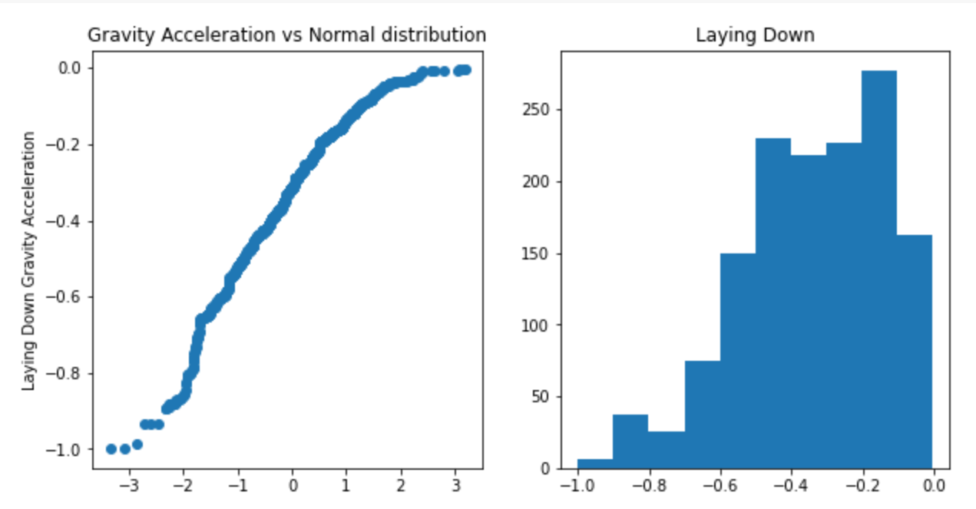
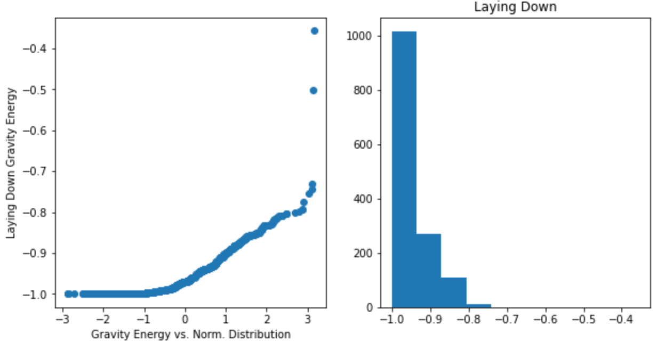
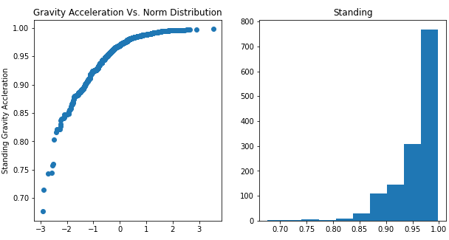
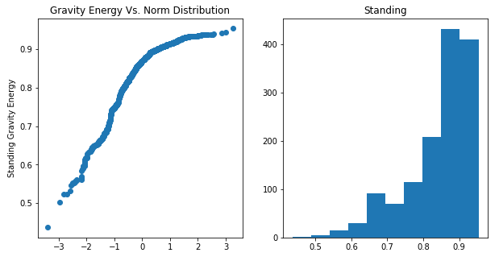
Feature Distribution
Visualize the relationship between ‘Gravity Acceleration’ and ‘Gravity Energy’ features to each type of activity. (Laying down, Standing, Walking etc., )
This is to demonstrate how a distinction can be identified between these features and the corresponding activities
Notes:
Moving from research question to some kind of hypothesis -- you want to use logic, theory and prior empirical evidence to move toward some hypotheses you can test. This is why domain expertise cannot be overlooked among data scientists.

Slide 8
Dataset Balance
I ) | Activity | Subject participants (%)
 | Laying | 19
 | Sitting | 17
 | Standing | 19
 | Walking | 17
 | Walking Downstairs | 13
 | Walking Upstairs | 15
II ) | Subject 1 | 5
 | Subject 3 | 5
 | Subject 5 | 4
 | …..
 | Subject 30 | 5
Dataset is well balanced between both activities and participants.
Notes:
Moving from research question to some kind of hypothesis -- you want to use logic, theory and prior empirical evidence to move toward some hypotheses you can test. This is why domain expertise cannot be overlooked among data scientists.

Slide 9
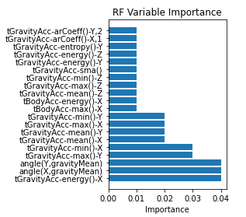
Multiclass Classification Modeling – Random Forest Classifier
Each cross validated accuracy: [0.9440678 0.84576271 0.92699491 0.89303905 0.93548387]
Overall RF classifier Accuracy: 0.91 (+/- 0.07)
Notes:
A statistical method is not a story, but we can tell a story from the statistics. For example, using confidence intervals we can put into dollars what we think would happen if we make some business move, given the data that we have.
The words “t-test,” “normality,” “independent samples” etc did not come up at all in this explanation! Although someone who does know about this stuff can still have confidence in the results with the way you have laid out the story and the quantifiable results.

Slide 10
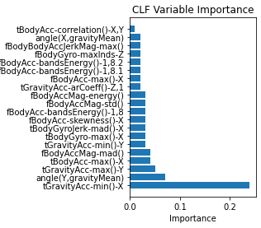
Multiclass Classification Modeling – Gradient Boosting Classifier
Each Cross Validated Accuracy: [0.92542373 0.83898305 0.95925297 0.91171477 0.96264856]
Overall Gradient Boosted Classifier Accuracy: 0.92 (+/- 0.09)
Notes:
A statistical method is not a story, but we can tell a story from the statistics. For example, using confidence intervals we can put into dollars what we think would happen if we make some business move, given the data that we have.
The words “t-test,” “normality,” “independent samples” etc did not come up at all in this explanation! Although someone who does know about this stuff can still have confidence in the results with the way you have laid out the story and the quantifiable results.

Slide 11
Multiclass Classification Modeling – Support Vector Classifier
Each Cross Validated Accuracy: [0.97118644 0.86779661 0.94397284 0.93378608 0.93378608]
Overall Support Vector Classifier Accuracy: 0.93 (+/- 0.07)
Notes:
A statistical method is not a story, but we can tell a story from the statistics. For example, using confidence intervals we can put into dollars what we think would happen if we make some business move, given the data that we have.
The words “t-test,” “normality,” “independent samples” etc did not come up at all in this explanation! Although someone who does know about this stuff can still have confidence in the results with the way you have laid out the story and the quantifiable results.

Slide 12
Conclusion
To return to my goals for this project, The Support Vector Classifier was able to achieve an R-squared values of 0.93 for predicting human activity from a smart phone’s internal sensors.
The SVM is very versatile and great as a classifier, but it comes at the cost of explaining which features are most important in my dataset.
If I need a model with accurate predictions, then I would choose SVM because it was able to achieve the highest average accuracy of 0.96
For a more explanatory model, the Gradient Boosting and Random Forest Classifiers are possible options.
Having more time would have helped me to focus on optimizing my dataset because there are so many features.
Furthermore, I want to create more explanatory models because it would help data scientist and engineers design better machines and models that focus on these important distinctions between activities
Notes:
https://unsplash.com/photos/OX_en7CXMj4
Then we want to move to recommendations, what is the call to action? What should your audience do now that they know what you have told them?

Slide 13
Questions?

Slide 14
Thank You

